Slide 2
2024 Strategic Action Plan
Theme: I Will Go for M.O.R.E.
Notes:
Good Day everyone it is a previallge to share a presentation on behalf of the Youth Ministries Department of Central Jamaica Confernce
Once again I am Grateful to the Lord for His leading in our lives to this very day, and I am humbled for the opportunity to serve our great conference
I am grateful for the Exemplary Leadership of my Predecessor Pastor Kevan Barnaby,
May God continue to bless and prosper him and his family along their future endeavors. I crave your prayers on their behalf.

Slide 3
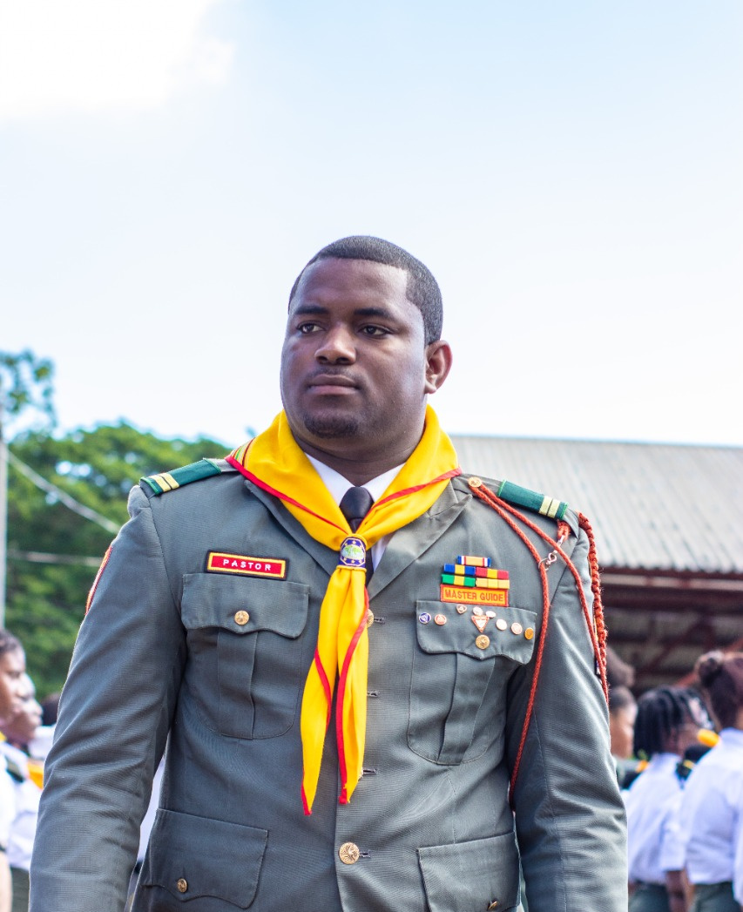
Youth Director’s Message:
The year 2023 is behind us and with resolute faith and confidence in Christ, we anticipate the challenges and victories of 2023. Thankfully, our God has shown himself big and has really been a very present help in troubled times. Psalm 34:3 "O magnify the LORD with me and let us exalt His name together".
I would like to express gratitude and commendations to all Pastors, Area Coordinators, Federation Executives, Adventist Youth Leaders, Pathfinder Directors and Adventurer Leaders for your willing and gallant efforts to advance the mission amidst great challenges. Undoubtedly, the Lord will continue to bless and affirm our tremendous labour as we go forward in 2023 in his name.

Slide 4
Vision Statement
Ministry conducted for, with and by Youth.

Slide 5
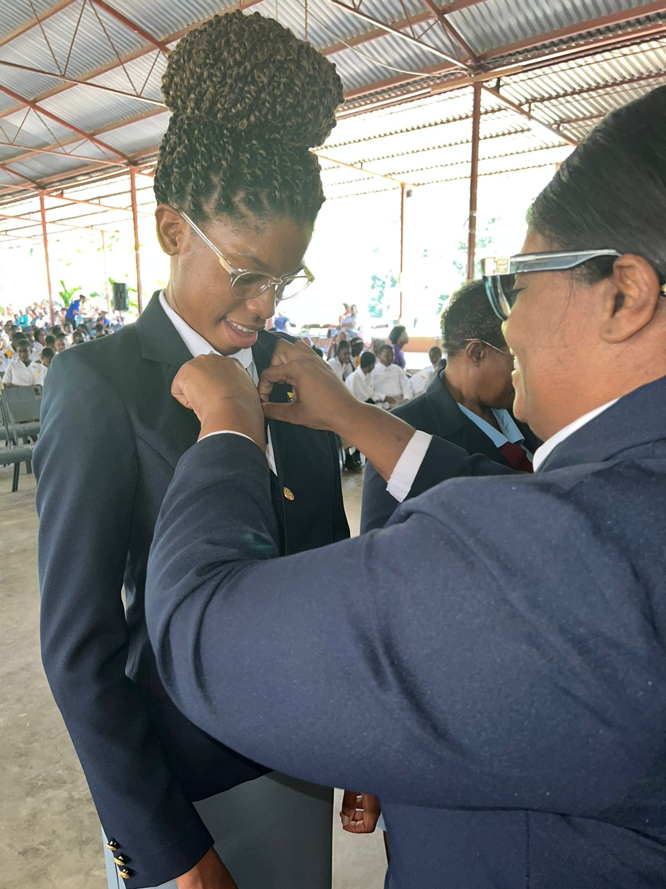
Mission: to engage, train, and mentor our youth to spread the love of Jesus in every community.

Slide 6
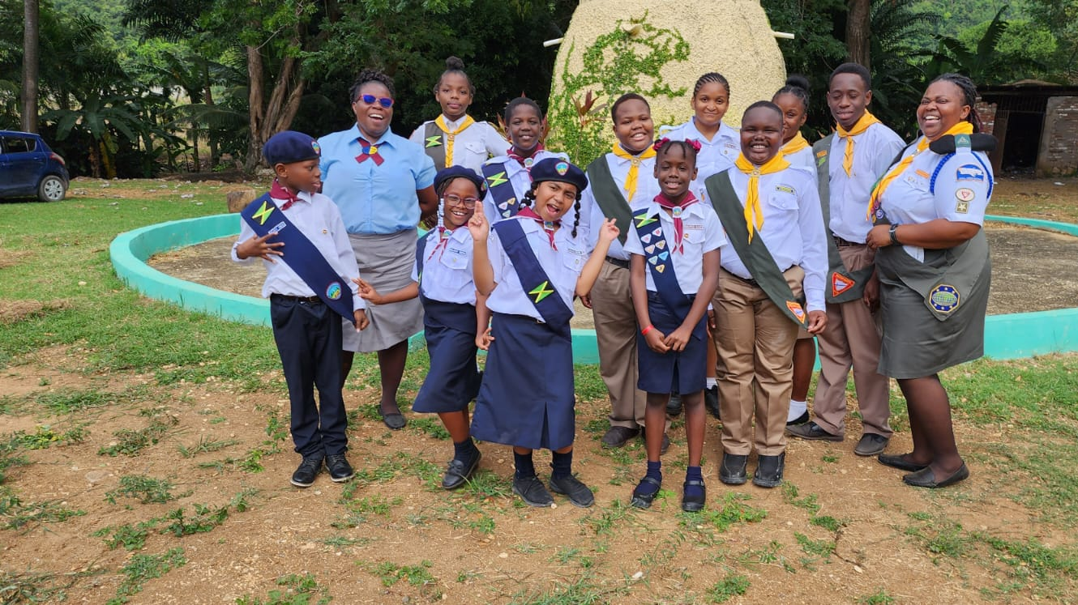
OUR PROPHETIC MANDATE
The Lord has provided a Prophetic Mandate to every Seventh-day Adventist youth, (Ecc. 12; Joel 2:28-29) of the uniqueness of this post-modern age or “the last days”, to declare the unadulterated truths revealed in His Word and an urgent message to His people through His divinely-anointed youths.

Slide 7
C.J.C. STRATEGIC IMPERATIVES
1. Spiritual Growth and Christlike Living
2. Health and Family Wellness
3. Humanitarian Service & Development
4. Education/Training, Communication and Empowerment
5. Evangelism, Discipleship and Conservation
6. Prayer, Unity, and Stewardship

Slide 8
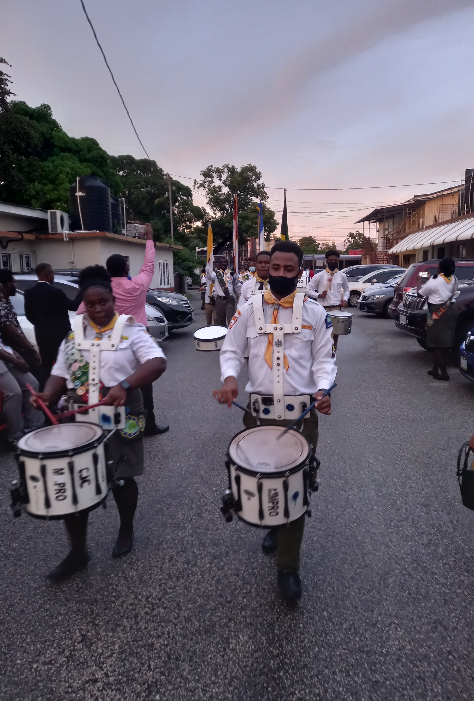
2024 Goals
RECLAIM 100 MISSING YOUTH
PROVIDE AVENUE FOR SPIRITUAL, PROFESSIONAL DEVELOPMENT
EMPOWER YOUTHS TO REMAIN FAITHFUL TO GOD AND ACTIVE IN CHURCH
PROVIDE EDUCATIONAL AND EMPLOYMENT OPPORTUNITIES
INVEST 1000 ADVENTURES, PATHFINDERS, SENIOR YOUTH AND MASTER GUIDES
INCREASE THE NUMBER OF ADVENTURES, PATHFINDERS, AMBASSADORS, MASTER GUIDES & SENIOR YOUTHS TO BE ENGAGED IN MISSION
REVIVE DORMANT PATHFINDER CLUBS AND A.Y. SOCIETIES
MAKE PRESENCE FELT IN CHURCHES AND COMMUNITY
PROVIDE AVENUE FOR YOUTH TO DISCUSS CURRENT ISSUES IMPACTING THEM: MUSIC, SEX, FINANCES, DRESS, RELATIONSHIPS ETC.
PROVIDE FRAMEWORK FOR YOUTHS TO ORGANIZE AND EXECUTE EFFECTIVE YOUTH MINISTRY
Notes:
(Get back to foundational youth ministry eg. Morning Watch, bands, drum and drill crops etc)

Slide 9
Our Ministries
Central Jamaica Conference

Slide 10
Administrative Structure of the CJC Youth Department
CJC Youth Advisory
Area Coordinators
Six (6) Federations
Central St. Catherine Youth Federation
Linstead Youth Federation
Manchester Adventist Youth Federation (MAYFED)
Clarendon Adventist Youth Federation (CLAYFED)
Old Harbour Youth Federation
Portmore Federation of Adventist Youth (PFAY)
District Associations
AY Committees in local churches

Slide 11
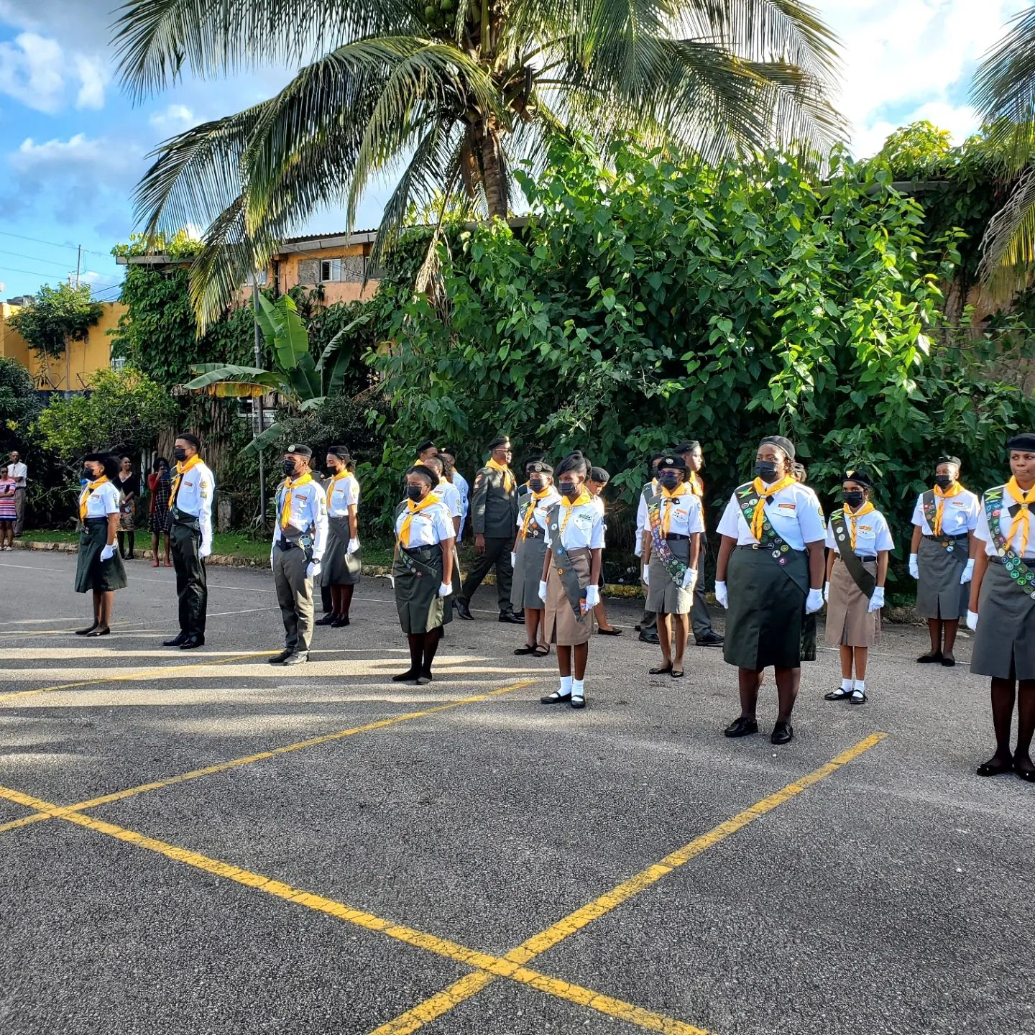
Registration Now Open for:
Osay 2024
SENIOR YOUTH & MASTER GUIDE TRAINING
DRUM CORP.
RECREATIONAL FOOTBALL & NETBALL LEAGUE
PATHFINDER & ADVENTURER CLUBS
Drill Camp

Slide 12
Save the Dates
Youth Ministries

Slide 13
Calendar of Events for 2024
January 12: Prayer Service for Youth, Children and Adolescents
January 13- 14 Revived and Renewed Youth Conference and Expo (JAMU)
January 20-21: CJC Drill Camp
January 27: Adventist Youth Society Inter-American Division Online Launch of I will go Mentorship (IAD)
January 28: Youth, Children and Adolescents Ministry Leaders Training
February 17: Youth Day/Senior Youth Investiture
February 24: HYPERLINK (JAMU)
March 16: Global Children/Youth Day (GC)
March 17: O-Say (Clarendon)
March 17-23: Youth Week of Prayer (GC)
April 6: JAMU in Mission & Youth Bible Conference (JAMU)
April 13: Virtual Program for Teens (IAD)
April 27: HYPERLINK (JAMU)
April 28: Launch of CJC Recreational Football & Netball League
May 1-31: Child’s Month
May 18: Youth Day/ World Adventurers Day (GC)

Slide 14
Calendar of Events for 2024
May 19: Pathfinder and Adventurer Rally (Federation)
May 24 – 26: Master Guide Congress & HYPERLINK (JAMU)
May 26- May 31: Children and Adolescents Week of Prayer
June 1: District Children Convention
June 2: Children and Adolescent Fun Day
June 1-30: I WILL Go Mentorship Month (IAD)
June 8: Master Guide Day
June 29: HYPERLINK (JAMU)
June 22: World PCM Day (GC)
July 1-31: Youth Evangelism Exchange and Impact (JAMU)
July 13: Adventist Youth Society (IAD)
July 16 – August 6: CENCONYOUCA Summer Camp
July 20: Children Sabbath (GC)
July 27: Virtual Program for Teenagers (IAD)
July 28: Creative Arts Festival & HYPERLINK (JAMU)
August 1-31: Vacation Bible School
August 5-11: International Pathfinder Camporee (GC)
August 17: Youth Day (Conference Wide)
August 18: CJC Sports Day
August 24: CJC Bible Connections Finals
August 31: Bible Connection Finals & HYPERLINK (JAMU)

Slide 15
Calendar of Events for 2024
September 8-14 Pathfinder Scarf and Week of Kindness (JAMU)
September 21-22: Pathfinder Weekend
September 21: Public Campus Welcome Service (JAMU)
September 28: HYPERLINK (JAMU)
October 5: Adventist Youth Society (IAD)
October 12: Virtual Program for Teenagers (IAD)
October 13-16: Master Guide Training Camp
October 19 – 26: Adventist Roots & Culture Week (JAMU)
October: 25-27 Public Campus Ministries Congress & HYPERLINK (JAMU)
November 1-30: Youth in Leadership Month (JAMU)
November 9-15: E-Week of Prayer for Youth and Young Adult (GC)
November 16: Bible Connection – ELSU (IAD)
November 23: Youth Day
November 24: Youth Rally & Investiture Service
November 30: Youth Rally & Investiture
December 1: Youth Rally & Investiture

Slide 16
WORKING WITH THE UNDER SHEPHARD
Your Pastor can be your biggest ally in Youth Ministries in your church and because of that potential strength, youth leaders need to be careful to ask for and listen to the Pastor’s counsel. Youth Leaders are to be aggressive in keeping the Pastor informed, involved and active as a member of your Youth Ministries team. Here are a few tips on how to work successfully with your Pastor:
Create a regular appointment time - You should meet with your Pastor at least once per month.
Clear Calendar items - Stay at least one month ahead of major events, projects and programmes.
Discuss your strategies - Ask for advice and support.
Reveal specific plans - Discuss details of projects, special events, programmes, social events, and personnel.
Work on budgets - Go over your budgets together, line by line. Explain the financial support you need, the ways you intend to raise the necessary funds and what help you need from the church.
Give personal invitations - Be sure to invite your Pastor to attend programmes and events, give devotions to your youth group, and make appearances, even when he can’t stay for the entire event.
Evaluate - Ask for your Pastor’s opinion in specific events and programmes. Listen carefully. Take notes. Make the changes you can agree with.

Slide 17
“For The Love of Christ Compels Us”
“We are Servants of God and Friends to man”
“Because Jesus Loves Us, We can Always Do Our Best”
“Onward to the Prize Before Us”
We are Going for More

