Slide 1
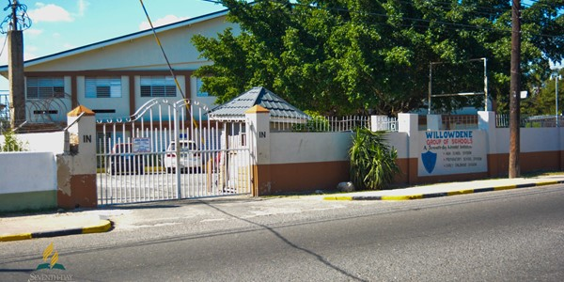
PROMOTING THE SDA BRAND:
EDUCATION FOR NOW AND THEN

Slide 2
Greek philosopher Aristotle once said,
“Educating the mind without educating the heart is no
education at all.”
For Seventh-day Adventists, education extends even
further—it reaches the soul.

Slide 3
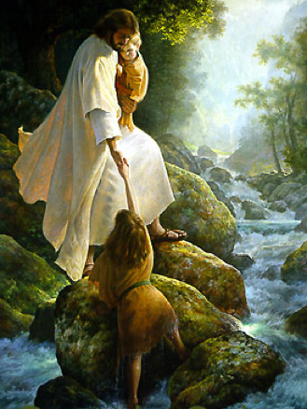
“The primary aim of Adventist education in the school, the home, and the church is RESTORATION - to lead children into a saving relationship with Jesus Christ.”
Dr. George Knight
”

Slide 4
The fundamental aim of education is to restore the broken relationship between God and the student. This sets the educational agenda and curriculum. All the other purposes of education are enlightened and molded by this primary purpose.”
Ellen White

Slide 5
When it comes to learning, our multifaceted lives require a multifaceted approach
Adventists aim to provide the complete package.
Education is not only about learning for the sake of intellectual growth.
Adventists believe in developing physically, intellectually, empathetically, socially as well as spiritually.

Slide 6
Ideally, education should change and cultivate every aspect of our lives, bringing us that much closer to what God originally planned for us to have and to be.
“To restore in man the image of his Maker…”
Education p. 15- 16

Slide 7
Adventist Education should:
reflect the heavenly “society”
God intended for us.
2. give us tools and resources to make
us wiser and healthier.
3. provide us opportunities to look
beyond ourselves and to serve others.

Slide 8
connect us as friends, as partners and as a community. Real love.
most importantly, help us fulfill our potential of being “good” citizens here, while eagerly anticipating an eternal citizenship in glory with God, our Creator.

Slide 9
Matt. 25:14-29: Education as Stewardship
A TALENT in Jesus’ day was equal to a sum of money—equivalent to fifteen years of daily wages.
A TALENT (since the Middle Ages) is also interpreted as an ability; eg. He is a talented athlete. She is a talented musician.
A TALENT Today
most often refers to a gift or ability that one has and can share with others.

Slide 10
Talents are not distributed in equal amounts—we have different resources and abilities.
One persons might be a talented musician, another an excellent Mathematician, while a third person might be both at the same time
Unions and conferences may vary in the number of universities, secondary schools, elementary schools and students; or in their financial standing

Slide 11
God expects us to be faithful in the use of all our talents, including the intellect. His plan for education includes the wise and careful development of all with which we can best fulfill our purpose for existence and be found faithful when He calls His servants – His stewards - into account

Slide 12
SDA Christian Education is our sacred TRUST
The dictionary defines a “Trust” as an arrangement whereby property legally owned by one person is administered for the benefit of another.
Whatever His reason, God has entrusted each of us with the sacred duty of advancing the merits of Adventist Christian Education to benefit our church, conference, union - our world.

Slide 13
So then, as stewards:
What has God left us in charge of?
Does it have a unique identity – a brand?
How should we model it? Promote it?
When, and to whom, do we pass it on?

Slide 14
ADVENTIST CHRISTIAN EDUCATION is defined and described by Ellen White as a unique and special entity
Multidimensional – catering to the mental, physical & spiritual domains
Lifelong – from the womb to the tomb
Service-oriented, not self-centred
Leading to joy and fulfilment
Eternal – preparing learners for the Kingdom of God
Education p.13

Slide 15
It must be shared intentionally, carefully, using the best methods and at every period of the student’s life
Deut. 6: 7
It must be modelled by teachers who take their example from Jesus because students best learn by example.
Education p.41
Its most important source is the word of God – the Living Word as found in the written word
Education p. 123 - 124

Slide 16
Manufacturers take pride in selling their prized product.
They invest in it when they know that:
the quality is excellent
it is something consumers really need
it brings immense profits to both manufacturer and consumer
THIS IS TRUE OF ADVENTIST CHRISTIAN EDUCATION

Slide 17
This sacred trust must be shared with our children
Deut. 6: 7; Is. 54: 13; Ps. 145: 4
It must be shared at home, at school and at church
Education p.283; 1 Sam. 1
All our children should have the opportunity for this education
Is. 54: 13

Slide 18
So then
What is so good about SDA schools?
Is it worth embracing? sharing?
If yes, why?

Slide 19
The principles of SDA Education were evident in the life of Christ.
St. Luke 2:52 – Wholistic. “And Jesus increased in wisdom and stature and in favour with God and man”. Jesus experienced it Himself.
St. Luke 24: 27 – Bible-based.“Beginning at Moses and the prophets, He expounded…” He used it in His ministry to His disciples

Slide 20
2. Workers demonstrate active
LOVE for each Child.
SDA Christian teachers/workers don't go into education to make money.
They enter the profession because of their passion for children and youth.
It is a mission to bond with students and help them achieve their greatest potential

Slide 21
They cherish their roles as surrogate parents
They revel in every opportunity to lovingly guide the students' character development.
They seek to follow Jesus, remembering that He said, “As the Father hah sent Me, so send I you”

Slide 22
Parents should therefore be comforted by the thought that their child/ren will be under the moment-by-moment influence of dedicated servants of the Lord who share their beliefs and who see each child as a candidate for eternal life.

Slide 23
Students catch that signal quickly and respond positively to it.
This brand of nurturing and accepting love will liberate each child to learn and grow in Jesus.
This is the very essence of a SDA school
Any Christian parent should want his/her child to be nurtured in this kind of environment.

Slide 24
3. The Bible is taught (not just religious education)
Bible, as a subject is taught every day.
Biblical principles are woven into every subject (integration of faith and learning)
Teachers/chaplains/counsellors model biblical principles daily
Special Bile classes are held for those who are seeking and have not fully committed to Christ

Slide 25
The Word of God is a superb educational resource because:
the Holy Spirit works through every page of it.
This is a "divine-human encounter" each child must experience.
It gives an infallible guideline for interpreting science and the mysteries of life

Slide 26
Through Bible classes, days & weeks of prayer, general worship sessions, clubs, school days, Bible studies, and community services, the children get a glimpse of the true character of God and
see Jesus for themselves
learn to trust Him
commit their young lives to their Forever Friend

Slide 27
The Bible in their everyday learning experience is critical.
Only through God's Word can they rightly comprehend the age-old cosmic conflict between good and evil
And intelligently decide which side they are on.

Slide 28
This is the education that will lead our children to know and appreciate truth, will root them in the faith, and equip them to face life’s challenges.
This is our unique brand: SDA. Christian Education.
Isn’t it worth embracing?
Isn’t it worth promoting?

Slide 29
4. Students are inducted into the Family of God.
In a SDA school students will comprehend that they are members of three families on earth
their own family at home
their church family
the school family
In addition they will come to realize they are part of and the emerging family of God on earth who will eventually live together in heaven.

Slide 30
Learning to respect and cherish each of these families is an important part of their SDA Christian education.
Students also learn that they are privileged to carry the good news of Christ's gospel and partner with God in extending His spiritual kingdom on earth.

Slide 31
They come to treasure being part of a family with a host of adults who will "be there" for them. Young people need that back up.
When they reach the point of decision they choose to take their place in the family through baptism
Parents and “school parents” rejoice with them when they make that big life’s commitment

Slide 32
Having made their commitment, they learn to be active, practising members, participating in local church outreach and service programmes
At school, these service opportunities are a natural part of their co-curricular activities, as teachers and students share these activities together
What a natural and practical way to teach leadership, witnessing, and service—by actually doing!

Slide 33
The home-school-church partnership, which will keep the children in "one world”, is of great importance
Christian psychologists are concerned that so many Christian children and youth are living in three incongruent worlds—home, school, and congregation—each with its own values, lifestyle, and demands.

Slide 34
This often causes confusion, depression, and loss of personal focus.
To simplify their lives, young people often abandon home and church influences for their media-saturated peer group
Though not usually seen as outright apostasy, it is a destructive trend. As parents and guardians, we need to make every sacrifice to reconcile the three worlds and anchor them in "the fold."

Slide 35
6. Divine inspiration is the driving force.
"Something better" is the watchword of true SDA Christian education:
This is achieved through the combination of inspiration and information.
The Bible, the prophetic guidance of Ellen White and other inspired writers must be combined with keeping our own hearts open to the Holy Spirit’s leading

Slide 36
What is truly important in education is more often caught than taught. Some call it "the hidden curriculum.
Every aspect of the SDA school's programme is calculated to make life's highest ideals irresistible, to build Christian character.
The classes, the assemblies, and the co-curricular activities—all will likely inspire children to aim high.

Slide 37
Here's where a SDA Christian teacher is an incalculable treasure:
In this critical hero-worshiping developmental stage, children look for someone to help them form their value system and goals. It is often a favourite teacher who inspires them.

Slide 38
7. Each Student will get a Good, Sound Education
Adventist teachers have consistent training programmes to meet rigorous preparatory standards in subject matter and pedagogy.
They also receive instruction in church doctrines, child/youth evangelism and other biblical principles.

Slide 39
In recognition of this unique role, the Seventh-day Adventist Church commissions its teachers as "Ministers of Education."
They are taught to be keenly sensitive to the psychological climate of learning in the classroom, and to help each child learn in their own way and at their pace.
Students are gently nudged ahead, building upon their successes while achieving high standards.

Slide 40
This is "quality education" in every sense of the term.
Today, many secular educators consider Adventist education a model of wholism and enrichment.
Adventist K-l2 teachers participate regularly in professional upgrading through denominationally sponsored workshops and in-service education.
Notes:
It's comforting to know that the teacher is not preparing them for tomorrow with yesterday's tools.

Slide 41
8. The child will be redemptively disciplined.
It is extremely important to know that when a child slips up (as will happen occasionally), a loving Christian teacher will treat him or her redemptively, not punitively. Redemptive Discipline is God's way, and it’s built on agape love.

Slide 42
Teachers ideally get each student to ponder the questions:
Why did I choose wrongly here?
How should I deal with such a situation the next time around?
What does this tell me about myself?
What principles from God's book will help me profit from this mistake?

Slide 43
The Christian SDA teacher is to turn a disciplinary mishap into a growth experience and a stepping-stone to better self-understanding and self-management.
Christianity of a school is evident in the way it treats students who run afoul of its rules.

Slide 44
This type of discipline is modelled after the character of God—-a blending of justice and mercy.
Discipline really means "making disciples," and each student deserves to attend a school that is doing just that.

Slide 45
9. The Campus Culture is Wholesome (not popular).
The popular culture of negative media, peer-pressure, sex, violence, violent video games, alcohol & high energy drinking, and partying with outrageous music are swamping schools—from early-childhood through university level.

Slide 46
Conservative SDA Christian parents are desperately looking for a safe, non-toxic place for their children—where innocence and wholesomeness are prized and order prevails. By the grace of God, our campuses strive to be such places and many parents and students will testify that this is what they are

Slide 47
Parents and leaders are aware that not every student in a SDA school is a modern Daniel or Esther.
However, we see each student as a candidate for Heaven and trust that the benefit of a wholesome campus atmosphere, along with other aspects of the curriculum will effectively contribute to Christian character development

Slide 48
The bottom line for SDA Education is:
It's worth fighting to keep
It’s worth sacrificing for
It's a gift from heaven that each of our children deserves.
It’s worth saving and definitely
It’s worth promoting.
Will you promote this brand of SDA education not just in words but in model?

Slide 49
Adventist Christian Education:
A system inspired by a wise God to restore in His children the spirit of wisdom (God's wisdom), and to prepare them for an eternity of joy with Him.
It is available for you and for your children. Claim this your goodly heritage for time and eternity.

Slide 50
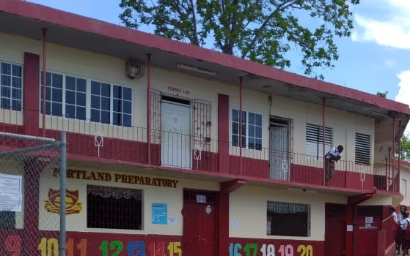
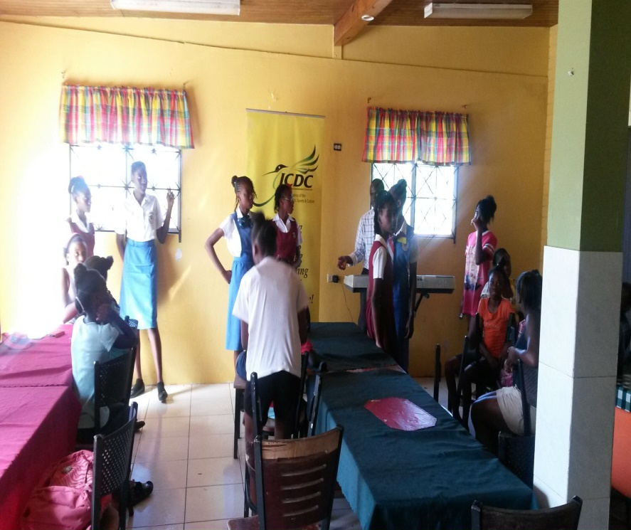
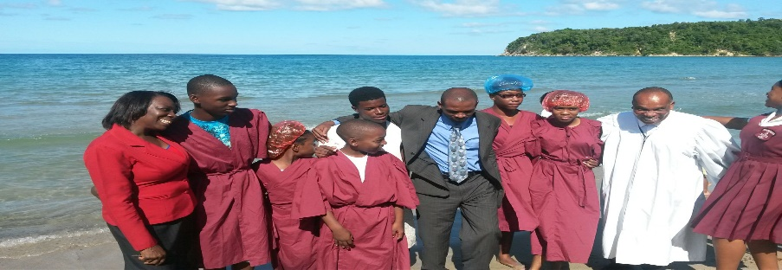
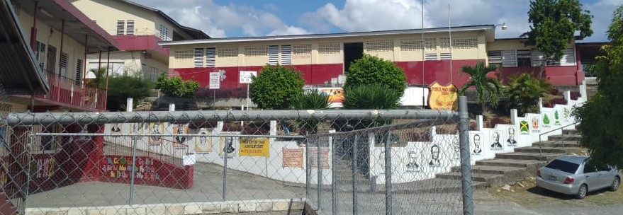
THE END

