Slide 1
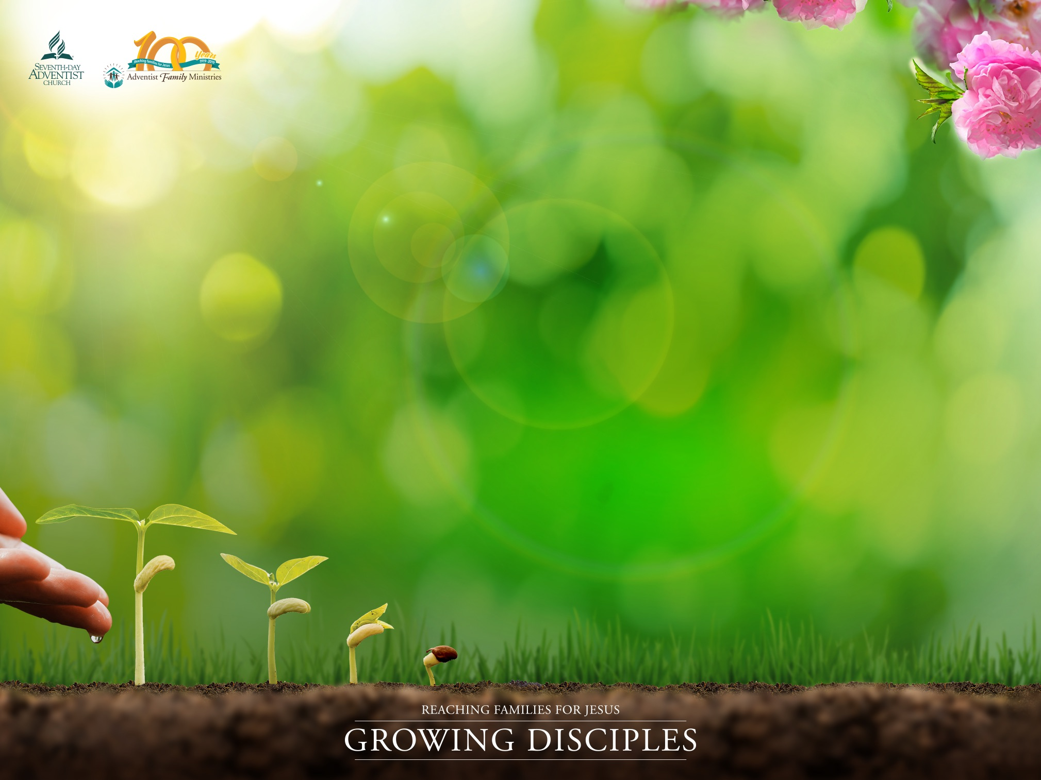
BUILDING YOUR MARRIAGE
ON THE ROCK
Presented by: (add presenter’s name here)
Written by Willie and Elaine Oliver
Department of Family Ministries
General Conference of Seventh-day Adventists World Headquarters,
Silver Spring, Maryland, USA

Slide 2

WEDDED BLISS
“Therefore a man shall leave his father and his mother and hold fast to this wife, and they shall become one flesh.” Genesis 2:24
BUILDING YOUR MARRIAGE ON THE ROCK
Notes:
Weddings are beautiful, delightful and blissful occasions. When a couple stands at the altar, holding hands, gazing into each other’s eyes, reciting their vows, they have so much promise and so much hope. Every couple believes their love is so special and their bond so strong, they will remain together “in sickness and in health.”

Slide 3
HAPPILY EVER AFTER?
STICKING, STUCK, OR STOP
40-50% of first time marriages will end in divorce.
Couples setting lower expectations
BUILDING YOUR MARRIAGE ON THE ROCK
Notes:
The reality is that most couples will end up on one of three paths: couples who stick, couples who are mostly stuck, or couples who simply stop (S. Stanley, 1998). In the United States and in many countries of the world, 40 to 50 percent of first time marriages will eventually end in divorce. What happens to the vows of staying together “until death do us part”? Is it that those making the vows didn’t take them seriously? Or is there a lack of true understanding of what the vows really mean. In addition, it seems that as couples hear about the high failure rate of marriage, they are watering down their marriage vows. Some vows now say, “as long as we both shall love” instead of “shall live”. It would appear that some couples are setting their expectations lower just in case they are not able to live up to such a high level of commitment.
With this daunting reality, how does a couple stay married for a lifetime, and happily so? How does a couple in today’s society build a marriage that is rock solid and not one that washes away with the sand?
Divorcestatistics.org
Eurostats.org

Slide 4
The Science of Love
“Falling in Love”
Infatuation/“Falling in Like”
The Power of Love
  Humans need to connect with someone
  Spouse is usually the primary or only source of support, comfort, and intimacy
  Loneliness and isolation are dangerous for humankind
  Scientists agree that people need to be in “forever” committed relationships
BUILDING YOUR MARRIAGE ON THE ROCK
Notes:
Most of us have heard about or have experienced first-hand falling in love. At least that’s what it is called in contemporary society. That giddy, butterflies in the stomach, rush of feelings we get when we meet someone we are powerfully attracted to. The truth is that this is not really love it’s just the body’s natural response to the neurochemicals that are being pumped into the brain when we meet someone that we find attractive. We prefer to call it “falling in like” or infatuation. Another truth is that this response is not sustainable with the same person unless we are intentional about connecting positively on a daily basis. The powerful force that connects us at the beginning begins to wear off once we stop all doing all the wonderful things we did at the beginning of the relationship and we have to negotiate the daily cares of life. Because we are wired (by God) to intimately connect with another human being, when the romantic feelings dissolve, we believe we have fallen out of love.
In the article “The Power of Love”, Sue Johnson (Johnson, 2016) states that new science is revealing how essential romantic love is to human beings. Sociologists and psychologists are also finding how this love works, why it goes wrong, and what couples can do to make it last longer. Their findings reveal that from ancient times, humans have had the need to connect with someone and this need provides trust, safety and security. Its opposite is isolation, which is coded in our brains as dangerous. Furthermore, these findings on love reveal that a life partner is often our only or most reliable source of support, comfort, and intimacy. In this age of growing isolation and loneliness, even scientists agree that now more than ever, people need to be in “forever” committed relationships and evidence suggests that it is possible to sustain the romantic bonds for a lifetime.

Slide 5
GOD AND MARRIAGE
Not good for the man to be alone
  Needs a helper
  Science agrees with the Bible
God created human beings to be in relationship with Him first
Then God created marriage because He knew we would need the kind of relationship where trust, safety, openness and closeness could thrive. That’s what we call intimacy.
  Marriage provides the safety of a covenant
  A mutually binding agreement that is not found in other replicas of this institution that is not found in other replicas such as cohabitation and consensual relationships.
BUILDING YOUR MARRIAGE ON THE ROCK
Notes:
At the end of creation week, after God had finished creating the heavens, the earth, the sun, the moon, the stars, the sea, the animals, the man, He looked at everything and “behold, it was very good” (Genesis 1:30). According to the Genesis account, everything was perfect—all but one thing—the man, Adam, was alone. Thus God declared, “It is not good that the man should be alone; I will make him a helper fit for him” (Genesis 2:18). Earlier, we said that new advances in social science have revealed that loneliness and isolation are dangerous and detrimental for our well-being. To be sure, it takes science a while to catch up with God, and it is very gratifying when it happens.
God created human beings to be in relationship with Him first and then with others. When He created Adam, and then Eve, He knew that humankind would need the kind of relationship where trust, safety, openness, and closeness could thrive. This is the definition of intimacy or the oneness that God talks about in Genesis 2:24, 25, “Therefore a man shall leave his father and his mother and hold fast to his wife, and they shall become one flesh. And the man and his wife were both naked and were not ashamed” God also knew that this high level of intimacy would require a deep vulnerability that would be quite risky without a covenant, so he instituted marriage. Marriage provides the safety of a covenant, a mutually binding agreement that is not found in other replicas of this institution, including cohabitation and consensual partnerships.

Slide 6
MARRIAGE AND THE FALL
“Like every other one of God’s good gifts entrusted to the keeping of humanity, marriage has been perverted by sin; but it is the purpose of the gospel to restore its purity and beauty…The grace of Christ and this alone, can make this institution what God designed it should be—an agent for the blessing and uplifting of humanity. (AH, 100.1, 2)
BUILDING YOUR MARRIAGE ON THE ROCK
Notes:
Sadly, in Genesis 3, we see the effect of Adam and Eve’s sin on marriage and family relationships. The beautiful admiration, mutuality, and oneness of the first couple gave way to defensiveness, blame, hostility, separation and selfishness. However, God himself provided restoration, hope and healing for humankind through His son Jesus Christ, including restoring His original design for marriage. In the book, The Adventist Home, Ellen G. White says this:
“Like every other one of God’s good gifts entrusted to the keeping of humanity, marriage has been perverted by sin; but it is the purpose of the gospel to restore its purity and beauty…The grace of Christ and this alone, can make this institution what God designed it should be—an agent for the blessing and uplifting of humanity. (AH, 100.1, 2
The feeling of falling in love is a beautiful thing. But relationships are dynamic and they are always changing. Thus, in spite of how deep this love seems, is it is based solely on a feeling and an extremely shallow level of commitment that will eventually fade or dissipate. However, with much effort, time, commitment and willingness to keep going, it is possible to grow and sustain (or reignite) a love that can be satisfying and stable for a lifetime.

Slide 7
COVENANT COMMITMENT IN CONTEMPORARY TIMES
Covenant love is a love that endures, renews, forgives, and restores. (2 Chron. 7:14)
God speaks about His relationship with us as a marriage
  He elevates marriage as a symbol of the union of Christ and the Church (Eph. 5:32)
Covenant love and commitment requires an interdependence that goes against the individuality of our postmodern times.
BUILDING YOUR MARRIAGE ON THE ROCK
Notes:
As we study scripture, the bible consistently points us to a creator God who longingly pursues His children with an everlasting love (Isaiah 54:5). In the Old Testament God invites the children of Israel to be His people and covenants with them to be their God. This covenant love is a love that endures, renews, forgives, and restores (2 Chronicles 7:14). In the New Testament God speaks about His relationship with His people as a marriage—thus elevating marriage as a symbol of the union of Christ and the Church (Ephesians 5:32). This is the biblical model for Christian marriage and family relationships. If we are going to do marriage and relationships the way God intended, then we must have a Christian worldview. We must understand and follow the ways of God.
In marriage, spouses have the capacity to mirror God’s covenant love to one another. Commitment that lasts a lifetime requires this type of covenant love. We can love our spouse unconditionally because we experience unconditional love from God (1 John 4:9, 10). In the book, A Model for Marriage, Jack O Balswick and Balswick (2006) posit that covenant love goes beyond loyalty to marriage as an institution and surpasses the need for self-fulfillment. Covenant love is a “promise to sacrifice for the sake of the relationship.” It is a commitment to care for the needs of each other, nurturing the relationship, and upholding the institution of marriage.
Covenant love and commitment requires an interdependence that goes against the individuality of our postmodern times. It also requires an egalitarian or mutuality that challenges traditional notions of marriage which resulted in legalistic and inflexible relationships. It is a lifelong commitment to investing in the marriage and holding on to the investment in good and bad times. When couples are intentional about spending quality time together doing joint activities, they learn to depend on each other, and this deepens their level of commitment.
This statement refers to people who are in relatively healthy relationships. It is not referring to people who are in abusive relationships or dealing with infidelity. Those who are experiencing such trauma in their relationship should consult with their pastor or a qualified Christian counselor.

Slide 8
ROCK AND SAND
MARRIAGE BUILDERS
Read Matthew 7:24-27
Two men and two different building styles
  One built on the Sand
  One built on the ROCK
BUILDING YOUR MARRIAGE ON THE ROCK
Notes:
This parable compares the building styles of two men, a wise man that built a house that was able to weather the heavy storms, and a foolish man who built a house that collapsed when the storm rolled in. Jesus then pointed out that those who only read His words but don’t practice them in their lives will not be able to weather the storms of life. The analogy to marriage is clear—couples that obey God’s word and apply them to their relationship will have a marriage that remains strong when the inevitable storms of life hit. Christian marriage is a marriage built on the Rock—the Rock of Jesus Christ.
A marriage built on the sand is based on an immature covenant and conditional love. It is dependent on temporary institutions such as career success, materialism, personal fulfillment, partner performance, and other worldly values. If and when one spouse feels the other spouse or the marriage is no longer meeting their needs, or one loses a job, or the there’s a financial crisis, the marriage is so badly shaken by these storms that it eventually dissolves.

Slide 9
TIPS TO BUILDING YOUR
MARRIAGE ON THE ROCK
Build your marriage on covenant love.
Accept each other’s faults and imperfections.
Listen, Listen, Listen to each other.
Forgive often.
Hug more.
BUILDING YOUR MARRIAGE ON THE ROCK
Notes:
When marriage is built on the Rock it provides a strong foundation for covenant commitment, trust, and intimacy to grow and thrive. This kind of marriage is based on a mature covenant and unconditional love and is fully possible through the power of Jesus Christ (Phillipians 4:13). God gives us His strength to remain faithful to our commitment in marriage and He provides guidance through His word to build a rock solid marriage. We offer below, five essential building steps for your marriage.

Slide 10
HAPPILY EVER AFTER?
If couples integrate these building steps into their marriage, they will build a marriage on the Rock and fortify it to weather the storms of life.
They will also experience the joy and satisfaction that God plans for every Christian couple. Ultimately God intends for us to be drawn closer to him; He wants to make us holy.
Far beyond our own joy and personal happiness, Christian marriage is for us to glorify God and be representatives of His grace and love here on earth.
BUILDING YOUR MARRIAGE ON THE ROCK

Slide 11
THE PROMISE OF SUCCESS
“I can do all things through him who strengthens me.”
Philippians 4:13
BUILDING YOUR MARRIAGE ON THE ROCK

