Slide 1
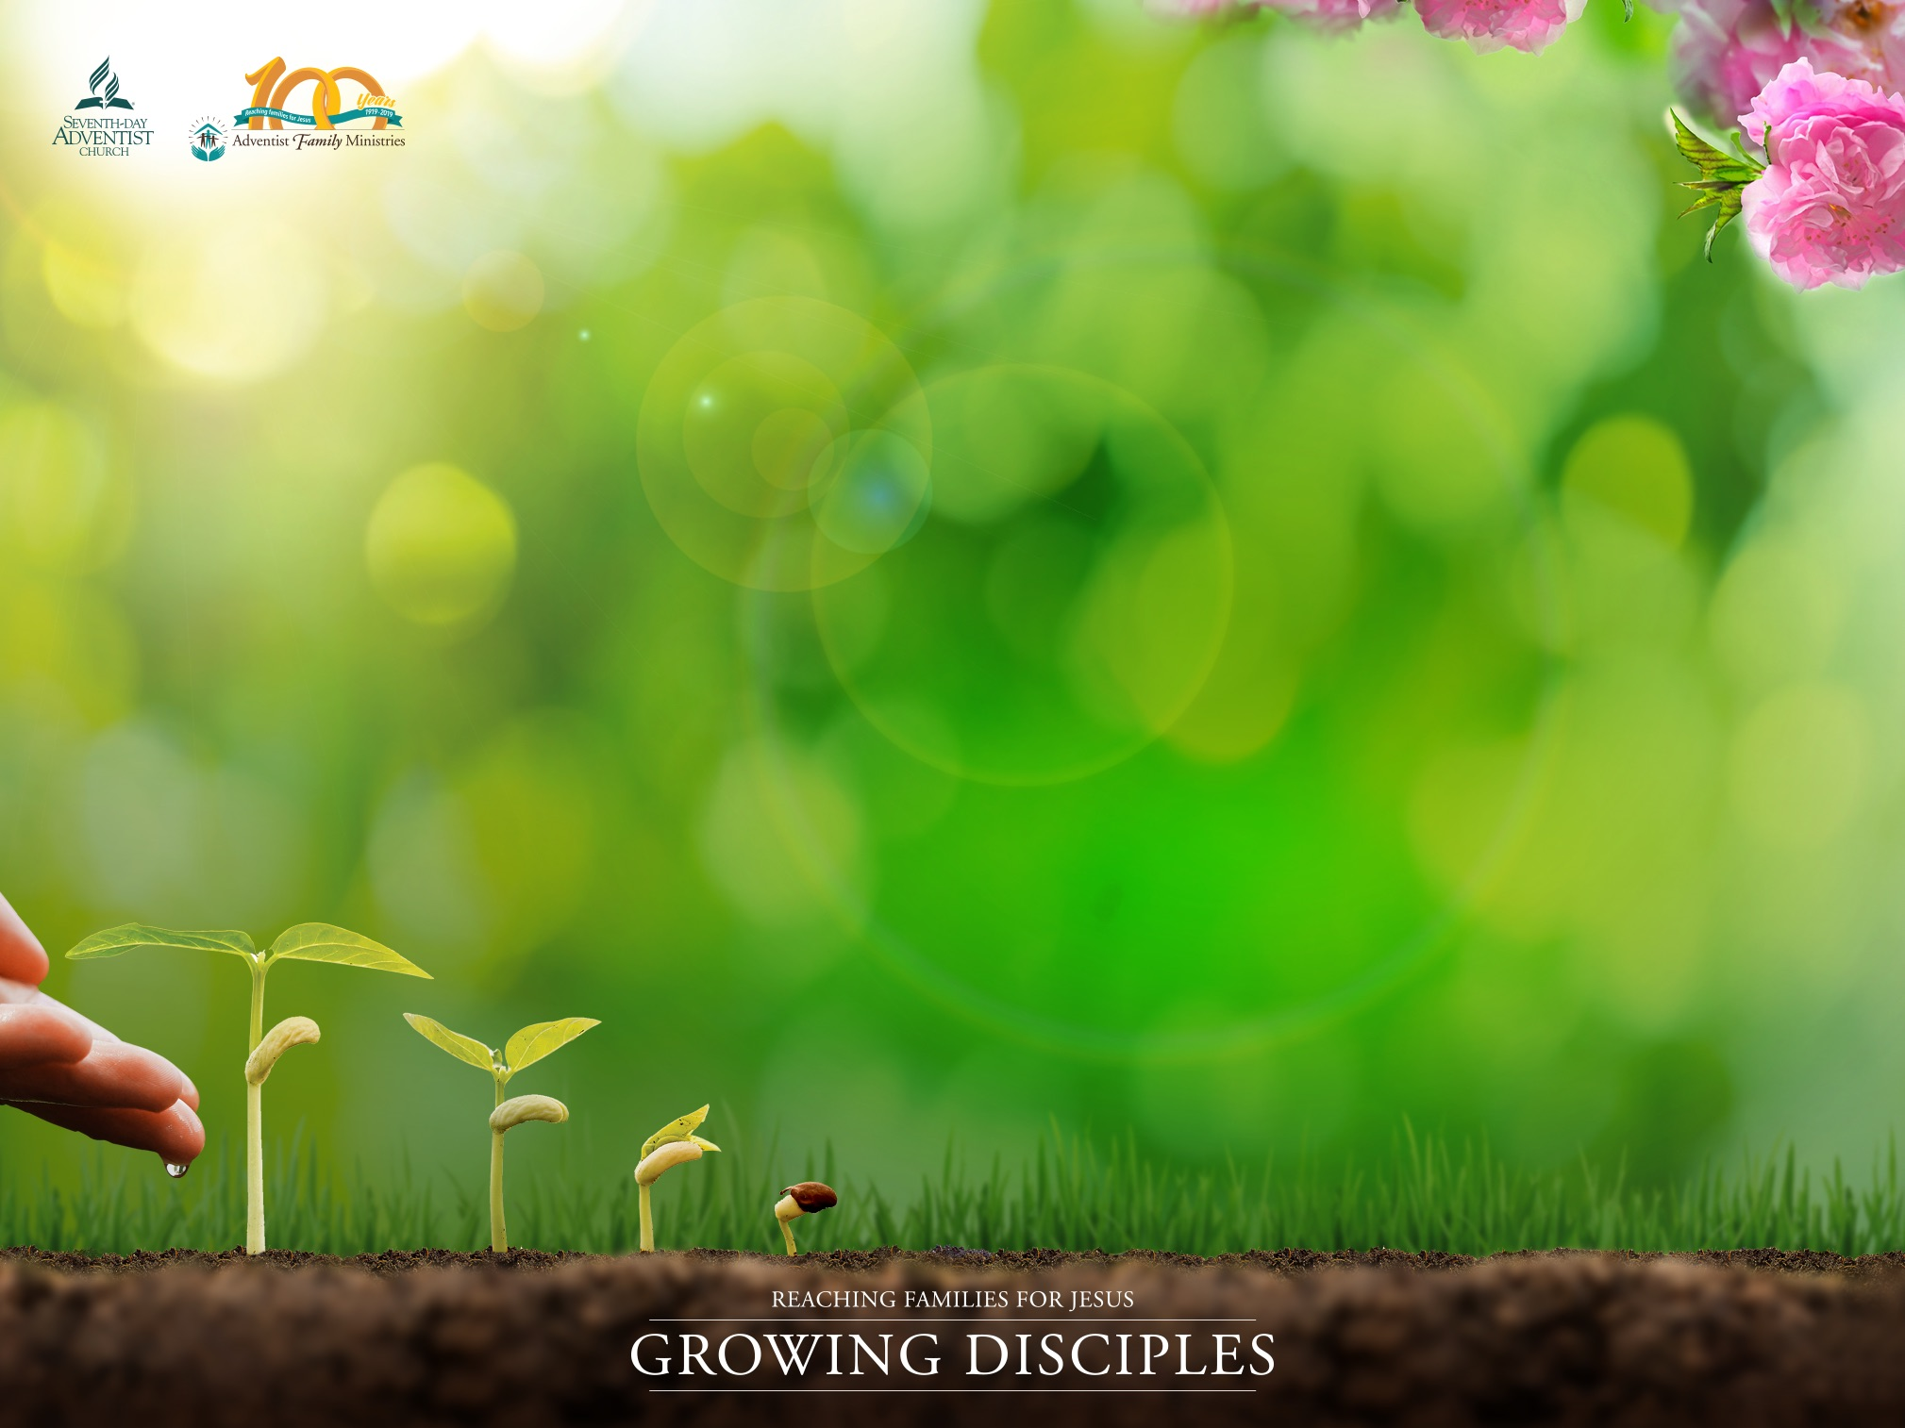
Growing Characters for Eternity
Presented by: (add your presenter’s name here)
Written by Karen Holford

Slide 2

But the fruit of the Spirit is love, joy, peace, longsuffering, kindness, goodness, faithfulness.
Galatians 5:22
Introduction
It is more helpful to describe character traits as ‘strengths’
We can strengthen our characters and the characters of our children
Finding ways to practice your character strengths, develop them and use them in different contexts just as we would strengthen our muscles
GROWING CHARACTERS FOR ETERNITY

Slide 3
What are character strengths?
Character strengths are durable, fundamental qualities that describe us at our best. Eades, 2008
Character strengths are positive qualities and values such as generosity, kindness, creativity, patience, humility
They are qualities that describe us at our best
They focus on what we have achieved in our most inspired and shining moments
GROWING CHARACTERS FOR ETERNITY

Slide 4
Exploring God’s Character
By focusing on God’s character, we will discover the kinds of character strengths that we need to develop to become more like Him
Psalm 145
In your group, list all the character strengths of God as revealed in this psalm
Think of three other character strengths mentioned elsewhere in the Bible
God’s character alphabet
On the sheet of paper, write the alphabet down the left side of the paper - one letter per line
Think of possible character strengths for each alphabet
GROWING CHARACTERS FOR ETERNITY

Slide 5
Developing character strengths
2 Peter 1:5-8 (NIV)
For this very reason, make every effort to add to your faith goodness; and to goodness, knowledge; and to knowledge, self-control; and to self-control, perseverance; and to perseverance, godliness; and to godliness, mutual affection; and to mutual affection, love. For if you possess these qualities in increasing measure, they will keep you from being ineffective and unproductive in your knowledge of our Lord Jesus Christ.
GROWING CHARACTERS FOR ETERNITY

Slide 6
Reflecting on your own character strengths
What are some of your top character strengths?
Write down three of your main character strengths?
How have these three character strengths been strengthened in your life?
Prayer
Experiencing the transforming power of God in your life
Everyday life experiences
The encouragement and nurture of other people
Persevering towards your goals
Other experiences….
What have you learnt that can help you nurture other character strengths in yourself, in children and others?
GROWING CHARACTERS FOR ETERNITY

Slide 7
Nurturing your child’s character
Nurture your child’s character strengths by giving your child small, fun and interesting opportunities to use their character strengths
Notice when your child is using their character strengths
Respond positively to their actions
Have intentional conversations about character strengths
GROWING CHARACTERS FOR ETERNITY

Slide 8
Ways you can nurture your child’s character strengths
Use the list in the handout #1 as a starting point
Create opportunities for your child to develop their strengths and notice when they are using them
Help your child to choose one or two character strengths they would like to work on
Pray that your child will grow more of this character strength
Help your child to make a list of things they could easily do at home, school, church or neighborhood to develop this character strength
GROWING CHARACTERS FOR ETERNITY

Slide 9
Nurturing character strengths through intentional conversations
Pick and choose different elements for variety and to suit your child and family context
Which character strengths did you use today?
What happened when you chose to use your strength?
Today I saw you use (name the strength) when (describe what happened). I was so proud of you for choosing to do that
Today I worked on (name the character strength you worked on during the day). And this is what happened….
Tomorrow I would like to work on (name a character strength) because…....
GROWING CHARACTERS FOR ETERNITY

Slide 10
Nurturing character strengths through family worship
Here are some simple ideas you can use in your family worships
Choose a character strength that you would like to develop as a family
Pray for inspiration and ideas about how God wants to nurture this character strength in each one of you and in your family
Search for Bible verses that speak about this strength
Make a list of all the ways you could practice this character strength as a family
Create a family journal together about the character strength
GROWING CHARACTERS FOR ETERNITY

Slide 11
Exploring a character strength
We will explore some of the character strengths in small groups
On your worksheet, list ways to nurture the allocated character strength
In 15 minutes, discuss and share ideas for nurturing your character strength through family worship activities, everyday experiences and practical family activities
Share your list of ideas and suggestions with everyone
GROWING CHARACTERS FOR ETERNITY

Slide 12
Reflecting on the seminar
Reflect prayerfully on your learning today
What would God want you to take away from the seminar?
In your private moment, complete the following sentences on a sheet of paper
The new things I have learned today about nurturing character strengths are…......
Three things I would like to do to nurture my own character strengths are….........
I will do this by….............
Three things I would like to do to nurture my child’s/family’s character strengths are…......
GROWING CHARACTERS FOR ETERNITY

Slide 13
Growing Characters for Eternity
Karen Holford, MSc, MA is the Director of the Department of Family Ministries at the Trans-European Division of the Seventh-day Adventist Church in St. Albans, Hertfordshire, United Kingdom

